Slide 1
Introduction to Excel for Statistical Analysis
Taught by Vaishali Kushwaha
Development Economics
Silvia Prina
Fall 2021
Feel free to ask questions at any point during the presentation!
Notes:
20 minutes, with 5 or 10 for questions

Slide 2
Workshop Agenda
Objectives
About Excel
Important Vocabulary and Functions
Demonstration
Activity: Practice Excel
Slides, handouts, and data available at https://bit.ly/diti-fall2020-prina

Slide 3
Workshop Objectives
Understand the data structures of Excel
Learn how to use basic Excel functions
Learn how to analyze your data with pivot tables and charts
Learn more advanced calculations like regression models

Slide 4

Excel
Excel is a program that is used to create and edit spreadsheets. In Excel, data are organized into rows and columns; data can be presented and analyzed using Excel’s functions, such as pivot tables, charts, formulas, and more.

Slide 5
Installing Excel (reminder)
For more information on installing Excel, visit the guide published by Northeastern’s ITS: http://bit.ly/2kDkYsL
Go to the Office 365 site (https://office.com) and enter your Northeastern email. You will be redirected to Northeastern’s Office 365 portal, where you can enter your email and password (same as your university email)
Once you’re signed in, click “Install Office” in the top right corner and “Office 365”. Excel is in this package
Follow the directions to download and install the Microsoft Suite

Slide 6
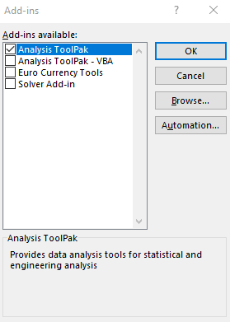
Installing ‘Analysis Toolpak’ (reminder)
Analysis Toolpak “provides data analysis tools for statistical and engineering analysis.” It is an Excel add-in that allows for easy statistical analysis like bivariate and multivariate regression. We will also show you how to do regression analysis without the add-in.
For MacOS: click on the “Tools” menu and select “Excel Add-ins”. In the “Add-ins available” box, check the “Analysis ToolPak” box. If you are unable to find this option, search for "Excel Add-ins" under the “Help” menu. If you have an older version of Excel, you may need to go to the Excel options in the “File” menu and find Add-ins there.
For Windows: Click the “File” menu, then select “Options”, then the “Add-ins” category. In the “Manage” box, select “Excel Add-ins” and then click “Go.” The “Add-ins” box will appear, and there you can select “Analysis Toolpak” and click “Ok”.
Compatibility: Excel for Office 365, Excel for Office 365 for Mac, Excel 2019, Excel 2016, Excel 2019 for Mac, Excel 2013, Excel 2010, Excel 2007, Excel 2016 for Mac.

Slide 7
Why Excel?
Excel is an excellent way to store, organize, and analyze data. It is particularly useful for quantitative analysis because most of its functions are designed for numerical data.
Please have Excel open now so you can follow along with this tutorial.

Slide 8
Important Vocabulary
Workbook: the overall Excel file that you are creating
Sheet: the different sheets inside the workbook; these can be renamed
Row: the horizontal and numerical rows
Column: the vertical and alphabetical columns
Cell: the boxes that each have an ID based on their row and column placements (A1, A2, A3, etc).

Slide 9
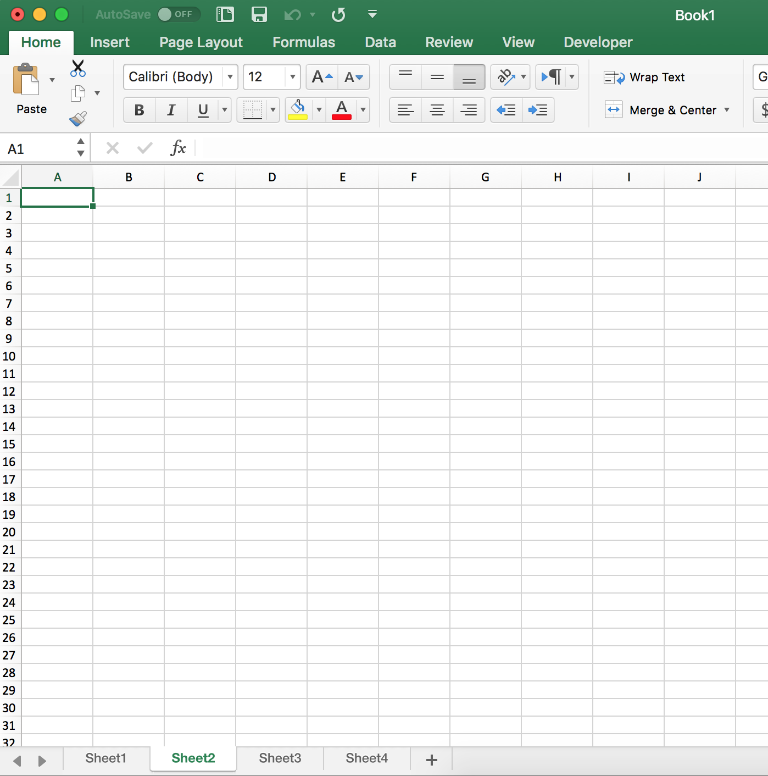
Anatomy of Excel
Excel
CELL
COLUMN
ROW
SHEET

Slide 10
Important Excel Features
Function: Used to calculate and analyze numerical data using mean, median, standard deviation, addition, subtraction, and other forms of arithmetic.
Tables and Pivot Tables: Used to filter, analyze, and calculate numerical data, and present different results based on functions and data chosen.
Charts: Used to visualize data with bar charts, scatter plots, and other formats.

Slide 11
How to Select Data
If you have a long dataset, it can be hard to drag your mouse down to the bottom of the dataset. Click
SHIFT + COMMAND/CONTROL + DOWN ARROW (or whatever direction)
The end of the data will be selected in the direction of the arrow you choose.

Slide 12
Basic Calculations
Using tables or functions, you can find the:
Average (Mean)
Mode & Median
Standard deviation
Min/max values
Correlation
Results for other basic calculations such as addition, subtraction, division, multiplication

Slide 13
Tutorial Scenario Goals
You are helping the Ministry of Health evaluate the effectiveness of a health program targeting poor households. The main objective of this program is to reduce the expenditure of low-income households in rural areas for health-related issues. A pilot has been carried out in several communities, and you have been asked to assess whether it actually generated a reduction in health expenditures for the beneficiary families.

Slide 14
Tutorial Dataset Variables
hhid: a unique ID number for each household (constant across rounds)
round: the year for which you have data (either 0 or 1 )
local: community identifier
hhe: the household health expenditure
treatcom: a dummy variable equal to one for the treatment community
agehh: age of the household head
educhh: years of education of the household head
hhsize: household size at baseline
pscore: the household poverty index
takeup: a dummy variable equal to one if the household participated in the program

Slide 15
Mean, Standard Deviation, Min & Max
1. Make a table that reports the means, standard deviations, and minimum and maximum values of all the household health expenditure, household head education and age, household size and poverty index in the dataset.
(a) How many observations are in the dataset?
(b) How many households are in the dataset ?
(c) How many localities are in the dataset?
(d) How many localities are in the treatment group? And how many in the control?
(e) How many households are in the treatment locality?
(f) How many households are in the control locality?

Slide 16
Mean, Standard Deviation, Min & Max
1. Make a table that reports the means, standard deviations, and minimum and maximum values of all the household health expenditure, household head education and age, household size and poverty index in the dataset.
(a) How many observations are in the dataset?
To answer this, think of observations as rows in our dataset.
How many rows do we have?
551
However, remember that the first row is our variable headings
Therefore:
551 - 1 = 550 observations

Slide 17
Mean, Standard Deviation, Min & Max
1. Make a table that reports the means, standard deviations, and minimum and maximum values of all the household health expenditure, household head education and age, household size and poverty index in the dataset.
(b) How many households are in the dataset ?
Remember the context of this assignment: You are analyzing a pilot study to see if an intervention has had an effect on household health expenditure.
Therefore, we have two observations for each household: one observation before the health program, and one observation after the program. A baseline and an endline.
So, 550 / 2 = 275 households

Slide 18
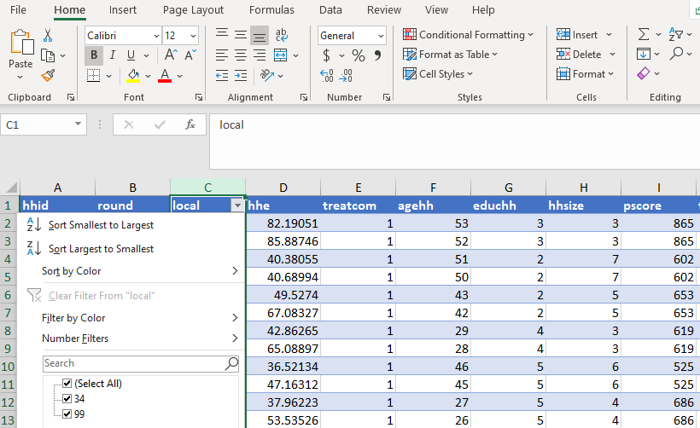
Mean, Standard Deviation, Min & Max
1. Make a table that reports the means, standard deviations, and minimum and maximum values of all the household health expenditure, household head education and age, household size and poverty index in the dataset.
(c) How many localities are in the dataset?
If we refer to our guide of what each variable is, we can see that ‘local’ is the community identifier, or the locality.
We can now look at this column in our dataset and see that we have two localities: 34 and 99.
Alternatively, we can also use the function:
=UNIQUE(C2:C551)
If we use the filter tool, we can also see the two localities.

Slide 19
Mean, Standard Deviation, Min & Max
1. Make a table that reports the means, standard deviations, and minimum and maximum values of all the household health expenditure, household head education and age, household size and poverty index in the dataset.
(d) How many localities are in the treatment group? And how many in the control?
If we refer to our guide of what each variable is, we can see that ‘treatcom’ is the treatment identifier, meaning if there is a ‘1’ that observation received the treatment, and if there is a ‘0’ then that observation was in the control group.
Therefore, we can see that locality 99 is the control locality, and locality 34 is the treatment locality.
So, there is 1 locality in the treatment group, and 1 locality in the control group.

Slide 20
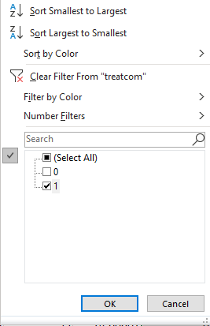
Mean, Standard Deviation, Min & Max
1. Make a table that reports the means, standard deviations, and minimum and maximum values of all the household health expenditure, household head education and age, household size and poverty index in the dataset.
(e) How many households are in the treatment locality?
To find the answer to this question, we will use filtering and then counting rows.
Filter ‘treatcom’ by only 1 to mark the treatment group.
If we filter by ‘1’ we can see that there are 263 rows - header = 262.
262 observations / 2 = 131 households

Slide 21
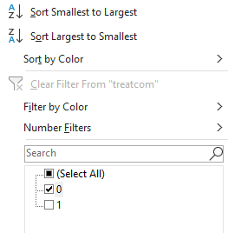
Mean, Standard Deviation, Min & Max
1. Make a table that reports the means, standard deviations, and minimum and maximum values of all the household health expenditure, household head education and age, household size and poverty index in the dataset.
(f) How many households are in the control locality?
To find the answer to this question, we will use filtering and then counting rows.
Filter ‘treatcom’ by only 0 to mark the control group.
If we filter by ‘0’ we can see that there are 289 rows - header = 288.
288 observations / 2 = 144 households

Slide 22
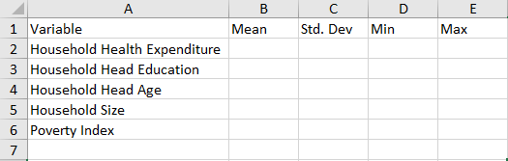
Mean, Standard Deviation, Min & Max
1. Make a table that reports the means, standard deviations, and minimum and maximum values of all the household health expenditure, household head education and age, household size and poverty index in the dataset.
Create a new table by clicking on the ‘+’ at the bottom of the page—this will be where we hold our results tables.
Title the columns: Variable, Mean, Std. Dev, Min, and Max
Under ‘Variable’ write the names of our variables: Household Health Expenditure, education, age, etc.

Slide 23
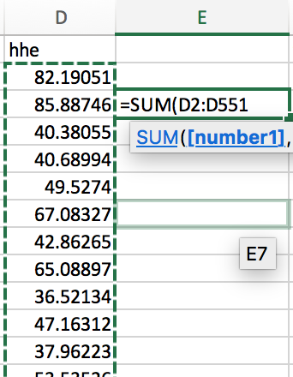
Writing Excel Functions
In an empty cell, type = and then the proper calculation:
Correlation: CORREL(
Sum: SUM(
Average: AVERAGE(
Standard Deviation: STDEV(
Select the range to calculate. If you are still in the function cell, the range will be automatically added for you as you select
Example: CORREL(B2:B20,C2:C20). B2:B20 is one range of values, while C2:C20 is another range.
We can also write functions referencing other worksheets by using the sheet name and ‘!’. Example:
=AVERAGE(Sheet1!D2:D551)
The selected data (D column from rows 2–551)
The function (SUM) with the selected data

Slide 24
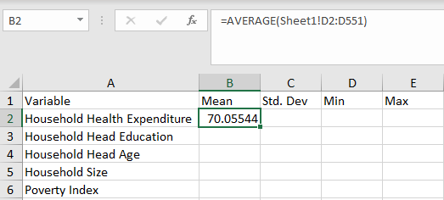
Mean, Standard Deviation, Min & Max
1. Make a table that reports the means, standard deviations, and minimum and maximum values of all the household health expenditure, household head education and age, household size and poverty index in the dataset.
In cell B2, write the following:
=AVERAGE(Sheet1!D2:D551)
This function is calculating the average of cells D2 through D551 on sheet 1.
We can now do the same for our other variables (Columns F,G,H, and I : Rows 2:551)

Slide 25
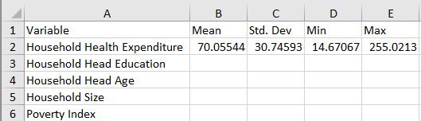
Mean, Standard Deviation, Min & Max
1. Make a table that reports the means, standard deviations, and minimum and maximum values of all the household health expenditure, household head education and age, household size and poverty index in the dataset.
Arithmetic Mean/Average function (for health expenditure): =AVERAGE(Sheet1!D2:D551)
Standard Deviation function (for health expenditure): =STDEV.S(Sheet1!D2:D551)
Minimum function (for health expenditure): =MIN(Sheet1!D2:D551)
Maximum function (for health expenditure): =MAX(Sheet1!D2:D551)

Slide 26
Your Turn!
Use the data to calculate the mean, standard deviation, minimum, and maximum for the rest of the variables.
Slides, handouts, and data available at https://bit.ly/diti-fall2020-prina
Notes:
Breakout Session: 5 MINS

Slide 27
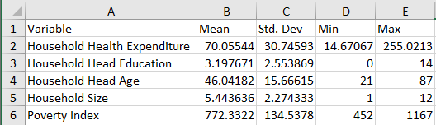
Final Results
Did anyone end up with different results?

Slide 28
New Variables and Calculations
2. Create a new variable called eligible, which is equal to one if the household has a poverty index lower or equal to 750.
(a) How many households in the treatment locality are eligible to be in the program?
(b) What fraction of households in the treatment locality are eligible to be in the program?
(c) Consider now the variable ‘takeup’: how many eligible household in the treatment locality participated in the program?
(d) What fraction of households in the treatment locality participated in the program?

Slide 29
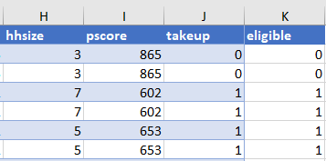
New Variables and Calculations
2. Create a new variable called eligible, which is equal to one if the household has a poverty index lower or equal to 750.
In column k, cell 1, name the variable “eligible”.
In K2, write the formula:
=IF(l2<=750,1,0)
=IF(l2<=750,1,0) is logical function saying if the cell in column l is less than or equal to 750, make the cell a 1, if not then, make it a zero.
Now you can copy the formula to every cell in the column by dragging the square in the bottom-right of the selection box, or by copying & pasting the formula into the rest of the cells in the column.

Slide 30
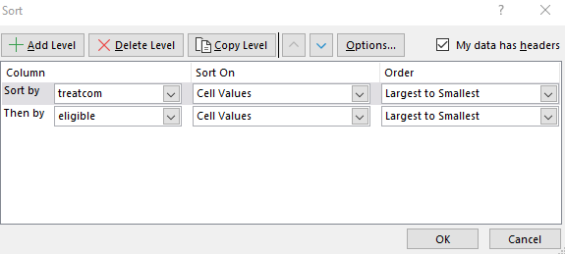
New Variables and Calculations
2. Create a new variable called eligible, which is equal to one if the household has a poverty index lower or equal to 750.
(a) How many households in the treatment locality are eligible to be in the program?
We can now calculate this by filtering our data by doing a custom sort (see screenshot below) and counting the 1’s for the treatment community.
Alternatively, we can filter by the treatment group (treatcom = 1), selecting column K, and due to the simple math of 0’s + 1’s we can use the sum calculated and shown at the bottom of Excel.
Either way, we have: 120 observations / 2 = 60 households eligible.

Slide 31
New Variables and Calculations
2. Create a new variable called eligible, which is equal to one if the household has a poverty index lower or equal to 750.
(b) What fraction of households in the treatment locality are eligible to be in the program?
Simple mathematics:
60 households (120 observations) / 131 households (262 observations) * 100 = 45.8%

Slide 32
Your Turn!
Try to find the answers to c) and d) on your own.
2. Create a new variable called eligible, which is equal to one if the household has a poverty index lower or equal to 750.
(a) How many households in the treatment locality are eligible to be in the program?
(b) What fraction of households in the treatment locality are eligible to be in the program?
(c) Consider now the variable ‘takeup’: how many eligible household in the treatment locality participated in the program?
(d) What fraction of households in the treatment locality participated in the program?
Notes:
2 MINS, No Breakout

Slide 33
New Variables and Calculations
2. Create a new variable called eligible, which is equal to one if the household has a poverty index lower or equal to 750.
(c) Consider now the variable ‘takeup’: how many eligible household in the treatment locality participated in the program?
Looking at the ‘takeup’ variable, we can see that this is also just 0’s and 1’s, so while we are still filtering for the treatment community (treatcom = 1) we can look at the sum at the bottom of Excel.
So, 118 observations or 59 households in the treatment locality participated in the program.

Slide 34
New Variables and Calculations
2. Create a new variable called eligible, which is equal to one if the household has a poverty index lower or equal to 750.
(d) What fraction of households in the treatment locality participated in the program?
Simple mathematics:
59 participated (118 observations) / 60 total households (120 observations) * 100 = 98.3%

Slide 35
Treatment and Control Baseline Tables
3. Make a table in which you report the average:
(a) household health expenditure (hhe);
(b) level of education of the household head (educhh);
(c) household size (hhsize);
(d) poverty index (pscore)
at baseline (round=0) for households in treatment and control localities separately.
Notes:
Walk Students through completely

Slide 36
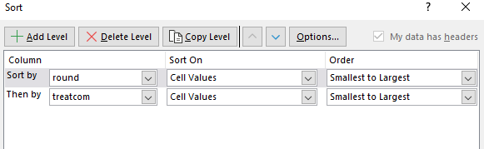
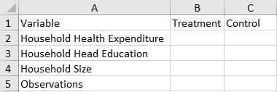
Treatment and Control Baseline Tables
The easiest way to make this table is to create a new sheet with the headings: ‘Variable,’ ‘Treatment,’ and ‘Control’ as seen below. Then on sheet 1, use custom sort (see screenshot below) where we can then do quick calculations by selecting the observations in the columns, looking at the bottom toolbar of Excel, and typing the figures manually into our table.

Slide 37
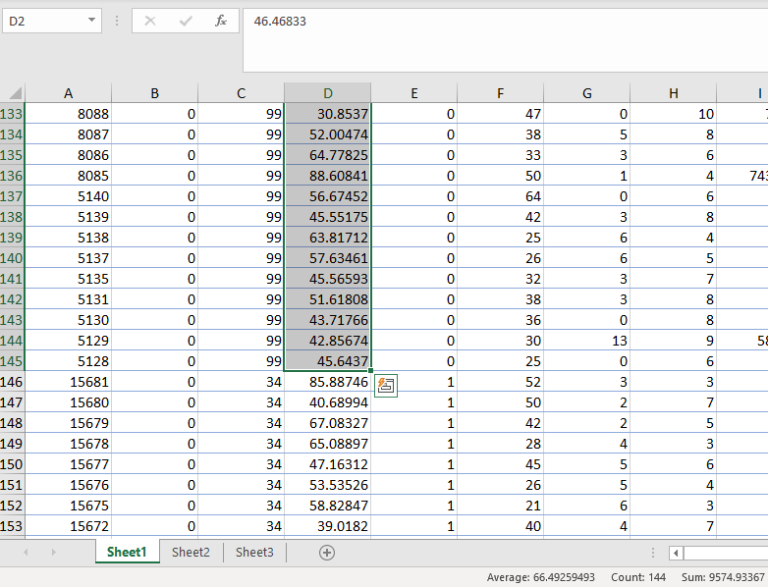
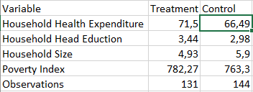
Results Example

Slide 38
Treatment and Control Baseline Tables
4. Make a table in which you report the average:
(a) household health expenditure (hhe);
(b) level of education of the household head (educhh);
(c) household size (hhsize);
(d) poverty index (pscore)
at baseline (round=0) for eligible households in treatment and control localities separately.

Slide 39
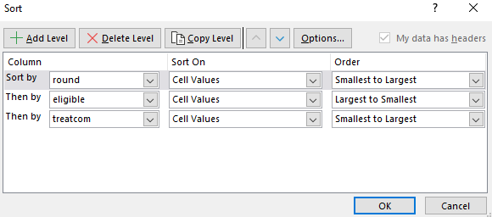
Treatment and Control Baseline Tables
This table can be created in similar methods to before, please refer to the custom sort image below (the table will look the same as in question 3).

Slide 40
Your Turn!
4. Make a table in which you report the average:
(a) household health expenditure (hhe);
(b) level of education of the household head (educhh);
(c) household size (hhsize);
(d) poverty index (pscore)
at baseline (round=0) for eligible households in treatment and control localities separately.
Notes:
Breakout Room: 6 MINS

Slide 41
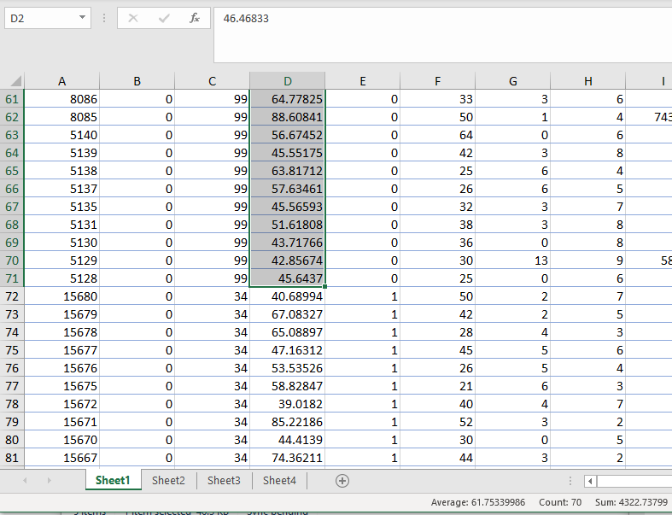
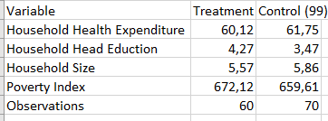
Results Example

Slide 42
Scatterplots
5. Make a scatter plot showing the relationship between household health expenditure at baseline and the household poverty index.
Paste the image (of the scatter plot) into your problem set.

Slide 43

Scatterplots
5. Make a scatter plot showing the relationship between household health expenditure at baseline and the household poverty index.
The first step is to clear any filters and sorting we have, and then filter by ‘round’ to make it only the baseline time (round = 0).
Once filtered, select columns D (hhe) and I (pscore).
To make a scatterplot, go to ‘insert’ and then under charts, click on this button: and select the option in the top left:
Then, with the scatter plot selected, click on the filter icon (the funnel), click on ‘edit’ on the lefthand side, and then insert the following values:
Series name: =Sheet1!$D$1
Series X Values: =Sheet1!$I$2:$I$276
Series Y Values: =Sheet1!$D$2:$D$276
Note that this path is different across different versions (eg. right click on scatter plot, and then click ‘Select Data’)
Note that we use I276 and D276 for the max limits of our formula because we have 550 / 2 households, one observation at the baseline (round = 0) and one at the endline (round = 1).

Slide 44
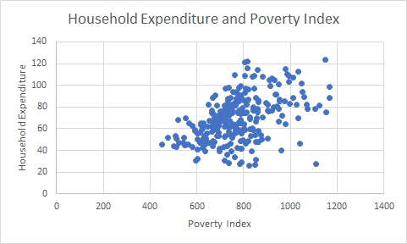
Scatterplots
5. Make a scatter plot showing the relationship between household health expenditure at baseline and the household poverty index.
(a) Paste the image (of the scatter plot) into your problem set.
We can also add axis titles and edit them by clicking on the ‘+’ button while selecting our scatterplot.

Slide 45
Scatterplots
5. Make a scatter plot showing the relationship between household health expenditure at baseline and the household poverty index.
Is the association positive or negative? In other words, does household health expenditure increase or decrease as the poverty index increases? Remember that the lower the poverty index, the poorer the household.
Referring to our scatterplot, we can see that the association between household expenditure and poverty index is positive (the dots generally go up and to the right). So poorer households spend less in health expenditure.

Slide 46
Correlation Coefficients
6. Calculate the correlation between household health expenditure and education of the household head at baseline. Is the correlation positive or negative?
First we will filter by baseline (round = 0) if we are not already doing so. Again, remember that we now have 275 rows (550 / 2).
Then in a clear cell (M2 for instance) we will write the following function:
=CORREL(D2:D276, G2:G276)
Which gives us: -0.099, so the two variables are weakly negatively correlated.
We can also calculate the correlation between the correlation between household expenditure and poverty index:
=CORREL(D2:D276, I2:I276)
Which gives us: 0.4691, so the two variables are positively correlated.
Notes:
1MINs

Slide 47
Bivariate Regression
7. Estimate the program's impact by regressing the health expenditure (hhe) variable on the treatcom variable using data from the year in which the intervention took place (round=1). Paste your Excel results into your write-up of the answers.
(a) How large is the estimated impact of the program?

Slide 48
More Advanced Calculations - LINEST
LINEST is a statistical function that uses the least squares method to calculate a regression line. OLS Equation:
y = a + bx1…bxn
y = expected value
a = intercept
bx1…bxn = beta-coefficient (b) * value (x)
Notes:
Definition of intercept: The intercept (often labeled the constant) is the expected mean value of Y when all X=0.
Definition of beta coefficient: The beta coefficient is the degree of change in the outcome variable for every 1-unit of change in the predictor variable

Slide 49
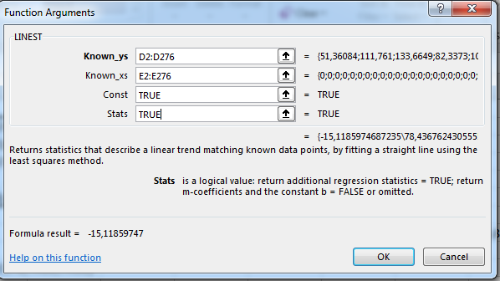
LINEST Excel Syntax
=LINEST(y_values, x_values, constant, additional_statistics)
Note: x_values, constant, and additional_statistics are OPTIONAL, but we almost always use them.
What is the relationship between variable
“hhe” and variable “treatcom” where
“round” = 1
LINEST Steps (after sorting for round)
Select multiple rows + columns (2x2)
=Linest(D2:D276, E2:E276, TRUE, TRUE)
=-15.12, 78.44 (Constant)
Note that the output might be different in
different versions of excel
Notes:
Give students 1-2mins to tryout WITHOUT breakout rooms

Slide 50
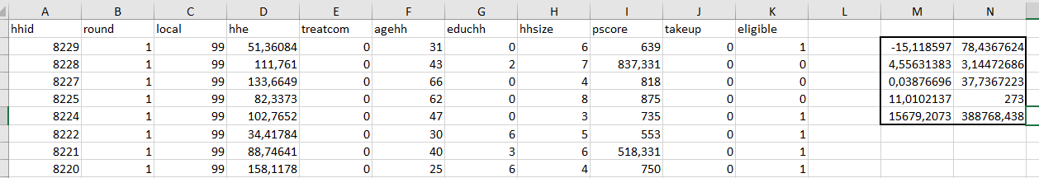
Bivariate Regression Example
Note that the second row from above are the standard errors.

Slide 51
Bivariate Regression
7. Estimate of the program's impact by regressing the health expenditure (hhe) variable on the treatcom variable using data from the year in which the intervention took place (round=1). Paste your Excel results into your write-up of the answers.
(a) How large is the estimated impact of the program?
With our results of -15.12, that means that after the treatment, the households in the treatment locality (1) spend approximately 15 dollars less than households in the control locality.

Slide 52
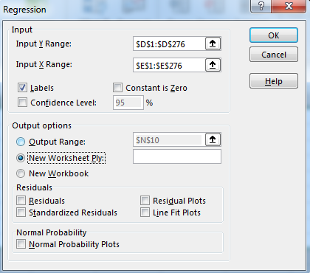
Regression with Analysis Toolpak
Use the “Analysis ToolPak” Add-in
Data → Data Analysis → Regression
The input data is similar to the LINEST method of regression:
Y range: D1:D276
X range: E1:E276
Also enable ‘Labels’ (D1 & E1)
Click ‘OK’
Notes:
Give students 1-2 mins to tryout WITHOUT breakout rooms

Slide 53
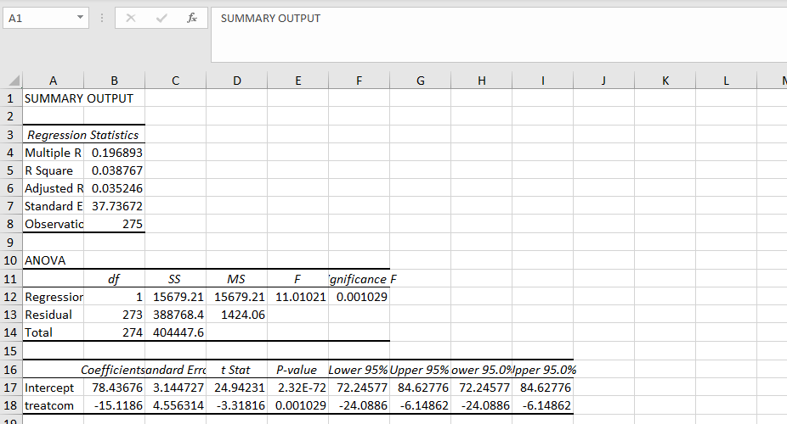
Analysis Toolpak Results

Slide 54
Multivariate Regression
8. Estimate of the program's impact by regressing the health expenditure (hhe) variable on the treatcom variable using data from the year in which the intervention took place (round=1) AND controlling for the level of education of the household head (educhh), the household size (hhsize), and the poverty index (pscore). Paste your Excel results into your write-up of the answers.
What is the relationship between “hhe” and “treatcom” while controlling for “hhsize”, “educhh”, and “pscore”
Be aware that the variables need to be next to each other, but “agehh” is in the way, so we will copy our data to a new sheet without that column.
Similar syntax: =LINEST(D2:D276, E2:H276, TRUE, TRUE)
Select rows & columns - you need 1 more column than the number of variables because of the constant - so we need 5x2
Note that the output of this is different from version to version
Notes:
4 minutes NO BREAKOUT

Slide 55
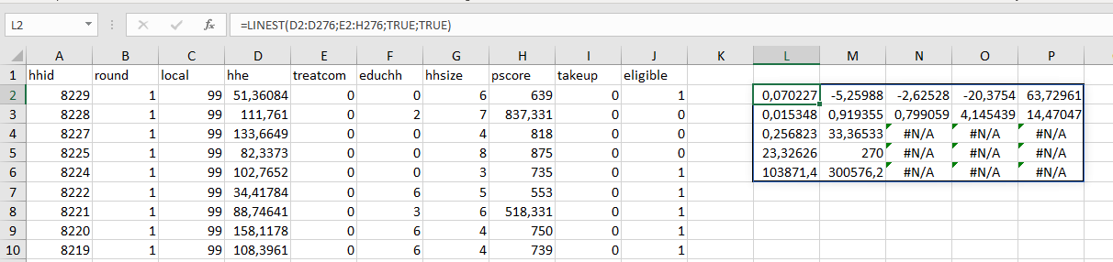
Multivariate Regression Example
So what do the results mean?
While controlling for household head education (-2.63), household size (-5.26), and poverty index (.07), after the treatment, those in the treatment locality spend approximately 20 dollars less on health care expenditure

Slide 56
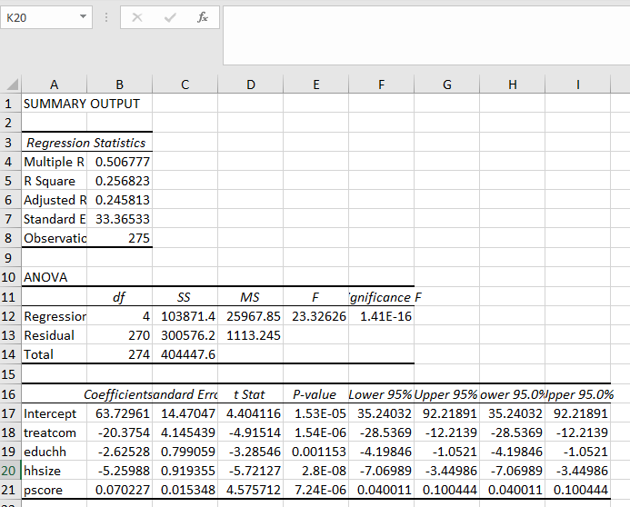
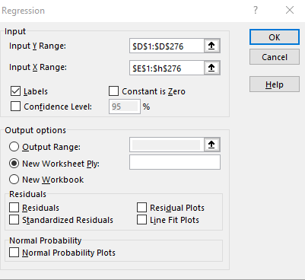
Add-In Example

Slide 57
Thank you!
If you have any questions, contact DITI at nulab.info@gmail.com
Developed by Garrett Morrow
Digital Integration Teaching Initiative
DITI Research Fellow
Taught by Milan Skobic
Digital Integration Teaching Initiative
DITI Research Fellows
Slides, handouts, and data available at https://bit.ly/diti-fall2020-prina
Schedule an appointment with us! https://calendly.com/diti-nu

Slide 58
Group Discussion
First, does anyone have questions?
How was using Excel? What are some easy features?
What are some more difficult features, or aspects that you think will be challenging to work with?
How might you use Excel in the future?
Notes:
10 minutes

